Slide 1


Predictive AI for Equitable Auto Repair Resources
This presentation explores how AI can optimize the distribution of auto repair services, ensuring equitable access and fostering sustainable economic growth.
by Philip Iringo and Mary Maina

Slide 2
Addressing Critical Infrastructure Gaps
The Problem
SDG 9 Focus
Many communities lack access to certified mechanics. This creates inefficiencies and unequal access to vital services.
Reliable vehicle repair is essential for resilient infrastructure. It supports economic growth and mobility networks.

Slide 3





AI/ML Approach: Predictive Modeling
Data Acquisition
Motor Vehicle Repair and Towing service data was gathered.
Preprocessing & Cleaning
Missing values were handled. Column names were standardized. Data was filtered by location and certifications.
Exploratory Data Analysis
Histograms, bar charts, and boxplots visualized disparities.
Modeling
Linear Regression predicted mechanic distribution.

Slide 4
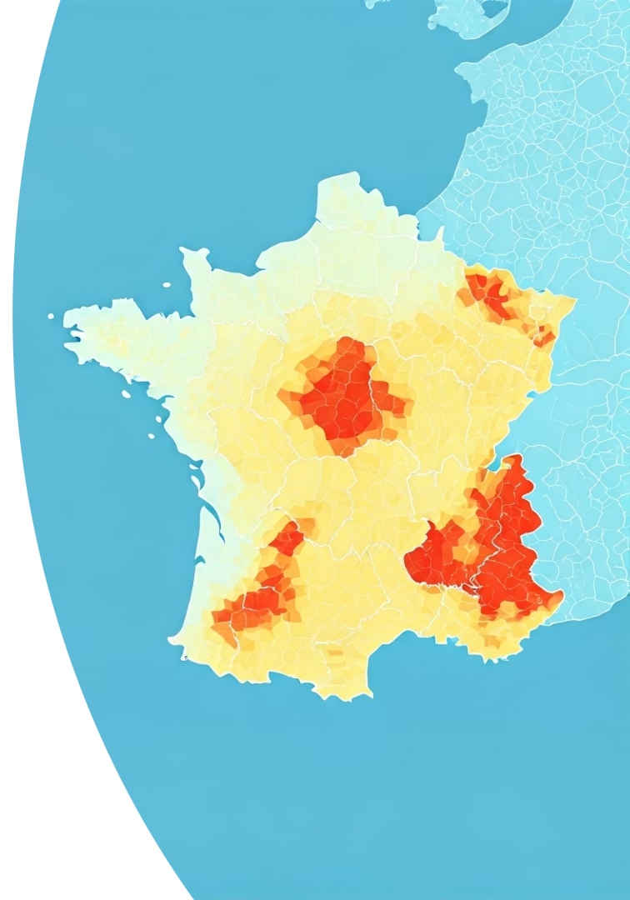
Key Findings: Geographic Disparities
Unequal Access
Urban Saturation
Some ZIP codes have minimal or no certified mechanics.
Urban areas are oversaturated with services.
Rural Underserved
Many rural locations lack adequate service coverage.

Slide 5
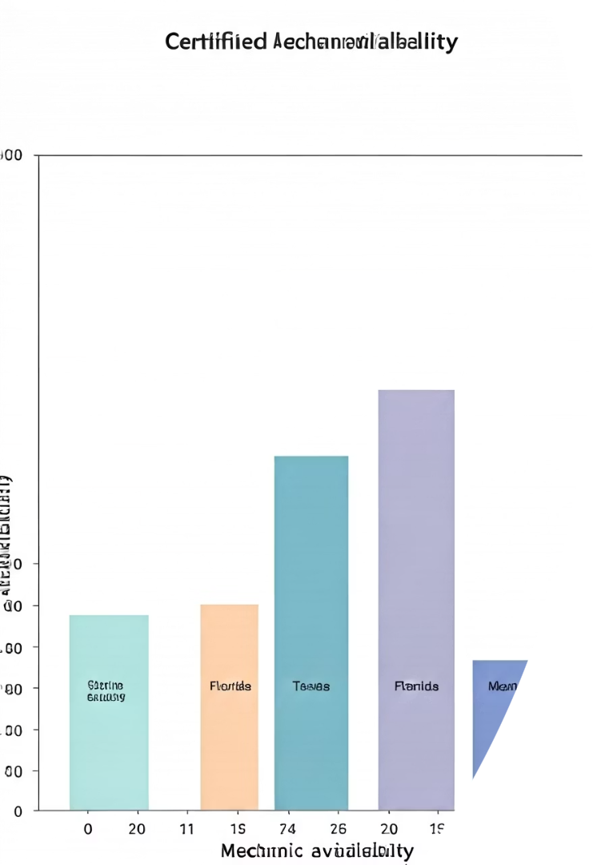
State-Level Inconsistencies
Maryland
50
2
California
35
4
Texas
28
6
Montana
10
10
Boxplots exposed significant state-level inconsistencies in certified mechanic availability, with rural states experiencing longer wait times due to limited service options.

Slide 6

Strategic Policy Implications
The model's results can support policy decisions. These include investments in training programs. They also guide strategic placement of new service centers.
Prioritize underserved areas for new infrastructure. This will improve accessibility.
Support vocational training to increase certified mechanics. This addresses skill shortages.
Incentivize repair businesses to open in rural areas. This promotes equitable distribution.

Slide 7




Ethical Considerations in AI Deployment
Bias in Data
Equity & Access
Data Privacy
Data concentrated in Maryland may skew generalizability.
AI decisions must not reinforce existing disparities.
No personally identifiable information was used.

Slide 8

Conclusion: AI for Sustainable Progress
Data-Driven Workforce Planning
Enables precise allocation of resources.
Equitable Service Distribution
Guides fair access to critical services.
Fostering Innovation
Drives progress in industrial logistics and mobility.
This model can scale into a decision-support tool. It serves governments, repair businesses, and community planners. Thoughtfully applied AI is an engine of sustainable progress.

